Slide 1

Understanding Sentiment AI
A Technical Guide to How Chat Data Becomes Insight

Slide 2
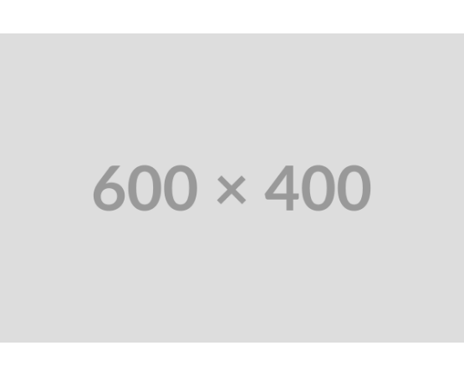
The Business Problem: Scaling Customer Insight
We are data-rich, but insight-poor.
We need an efficient, scalable way to understand the emotional tone (sentiment) hidden in thousands of daily customer chat logs.
•
Identify moments of high **frustration** in the chat flow.
•
Quantify the impact of **new product features** on customer mood.
•
Proactively manage agent performance and **de-escalation** success.

Slide 3
The Technical Pipeline
Converting unstructured text into a continuous numerical score using Natural Language Processing (NLP) and a Feedforward Neural Network.

Slide 4
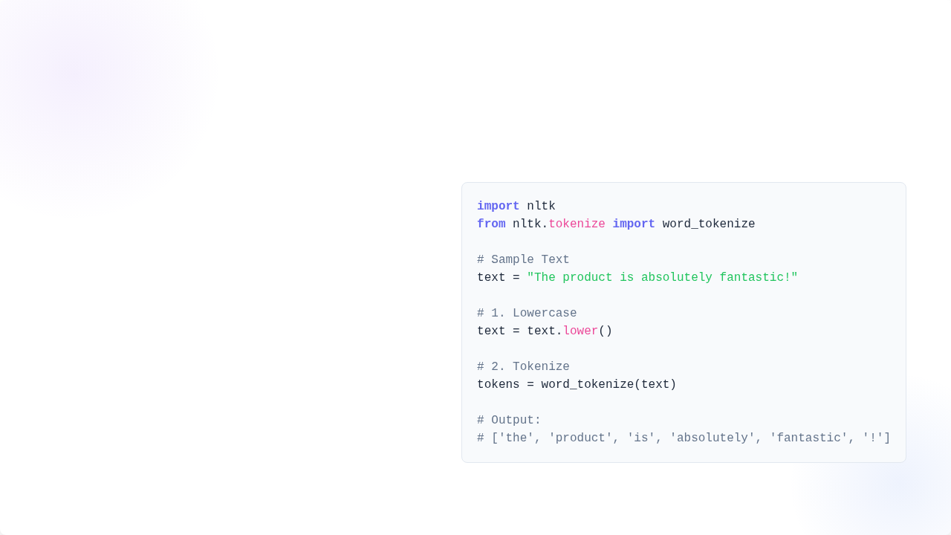
Step 1: Tokenization (The "Lego" Step)
Breaking Text into Processable Units
Python Implementation (NLTK)
Before a machine can read, it must segment the raw text into individual **tokens** (words, punctuation, or special characters). This cleans the data and prepares it for encoding.
•
**Lowercase:** Uniform text to treat "The" and "the" as the same token.
•
**Remove Stopwords:** Optionally remove common words ("is", "a", "the") that add little meaning.

Slide 5
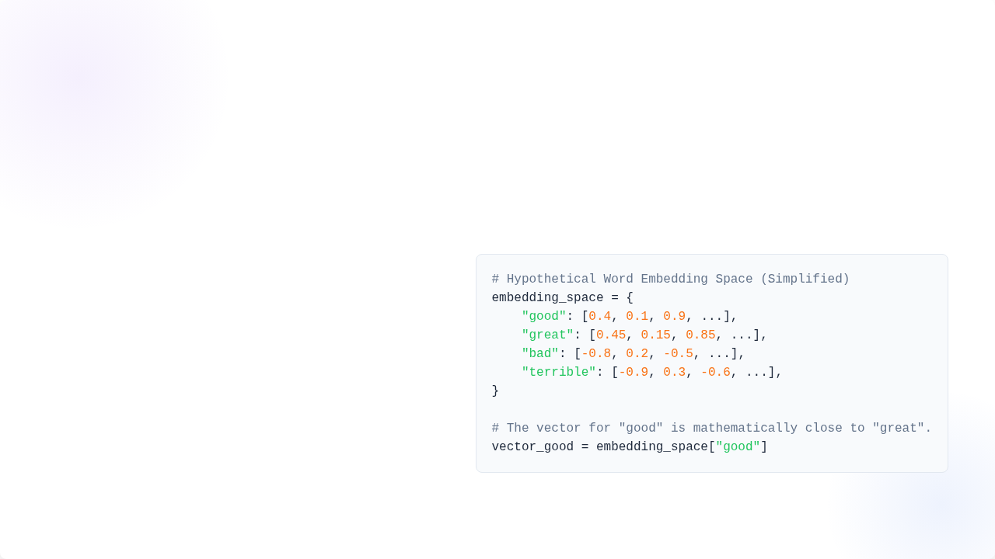
Step 2: Word Embeddings (Converting Words to Vectors)
Giving Meaning to Numbers
Conceptual Vector Look-up
A computer cannot process text, only numbers. **Word Embeddings** are vector representations (lists of numbers) that map words to a high-dimensional space.
Words with similar meanings (e.g., "angry" and "furious") are mathematically positioned **closer together** in this space, capturing semantic relationships.

Slide 6
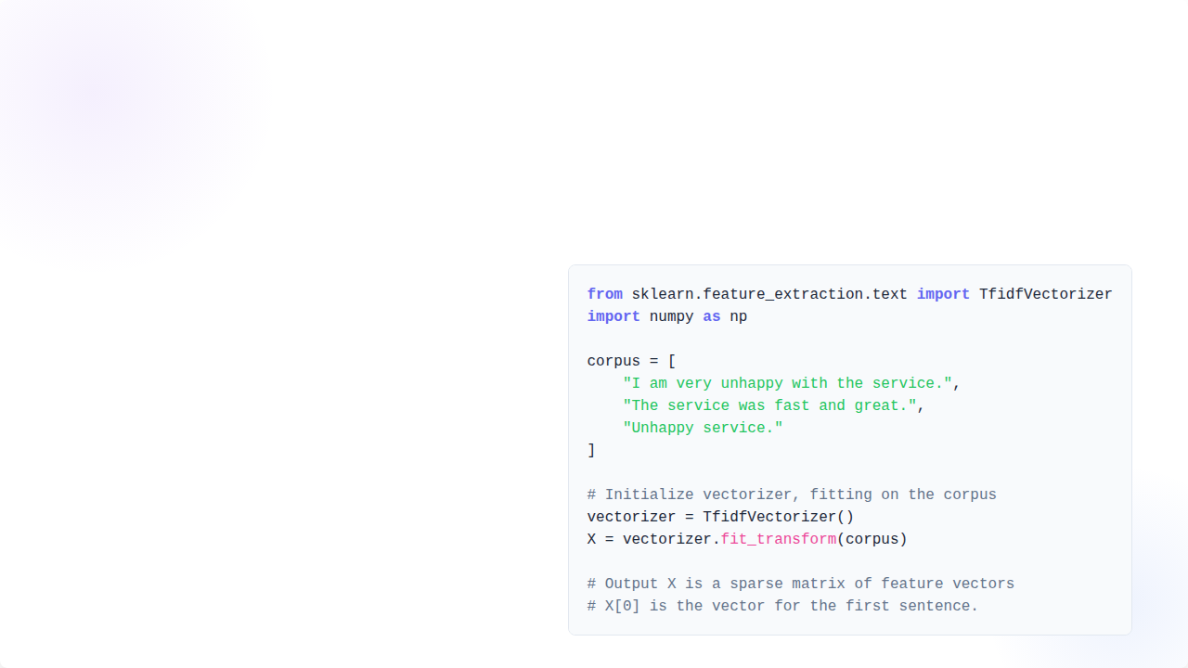
Implementation: TF-IDF (The Feature Extractor)
Term Frequency-Inverse Document Frequency
Scikit-learn TF-IDF
We use **TF-IDF** to generate a final vector for the entire chat message. This technique weights tokens based on how often they appear in *this* document (TF) versus how rare they are across *all* documents (IDF).
The result is a sparse vector where words like "amazing" or "broken" get a high feature value, while "the" gets near zero.

Slide 7
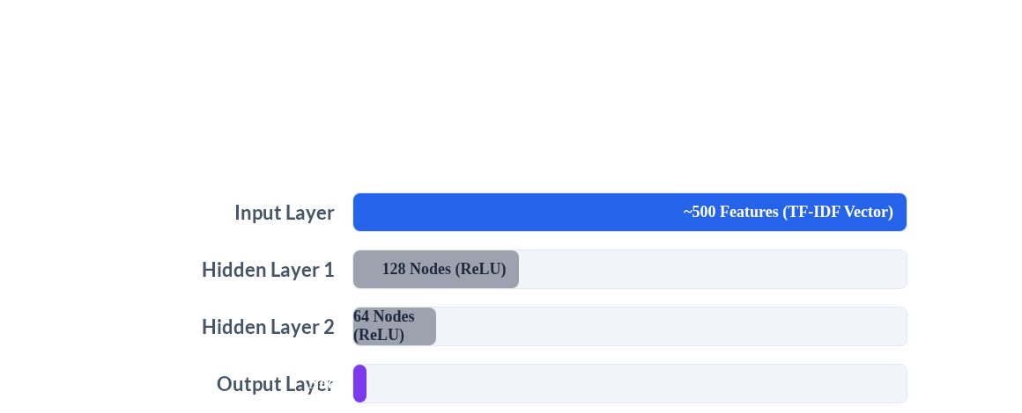
Step 3: The AI "Brain" (Feedforward Network)
FNN Structure for Regression
The **vector** (our input) is fed through interconnected layers. Each connection has a weight (a learned parameter), which the network adjusts to calculate the final sentiment score.

Slide 8
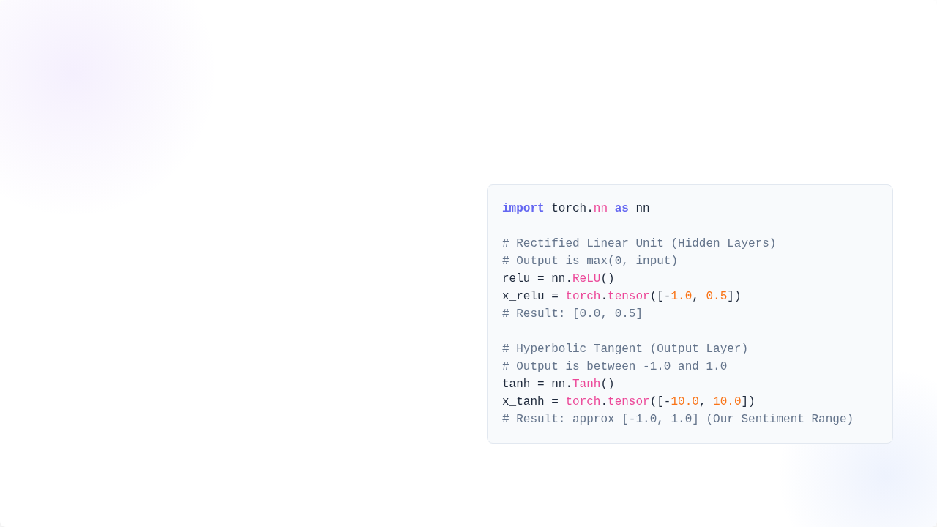
Key Component: Activation Functions
Introducing Non-Linearity (ReLU)
PyTorch Activation Definitions
The **ReLU** (Rectified Linear Unit) function is used in hidden layers. It introduces non-linearity, allowing the model to learn complex relationships that are not straight lines. It's fast and efficient.
Output Range Control (Tanh)
The **Tanh** (Hyperbolic Tangent) function is used in the final layer. It maps the output of the network to a range of **-1.0 to +1.0**, which perfectly represents our desired sentiment scale.

Slide 9






The Learning Mechanics: How the Model Optimizes
The "Referee" (Loss Function)
The "Coach" (Optimizer)
Backpropagation
The process of propagating the error backward through the network, allowing every weight to be updated proportionally to its contribution to the final error.
Calculates the **penalty score** by measuring the distance between the model's prediction and the true (labeled) sentiment. We use **MSE (Mean Squared Error)**.
An algorithm (**Adam**) that uses the Loss value to calculate the **gradient** (direction of steepest error reduction) and adjusts the model's weights accordingly.

Slide 10
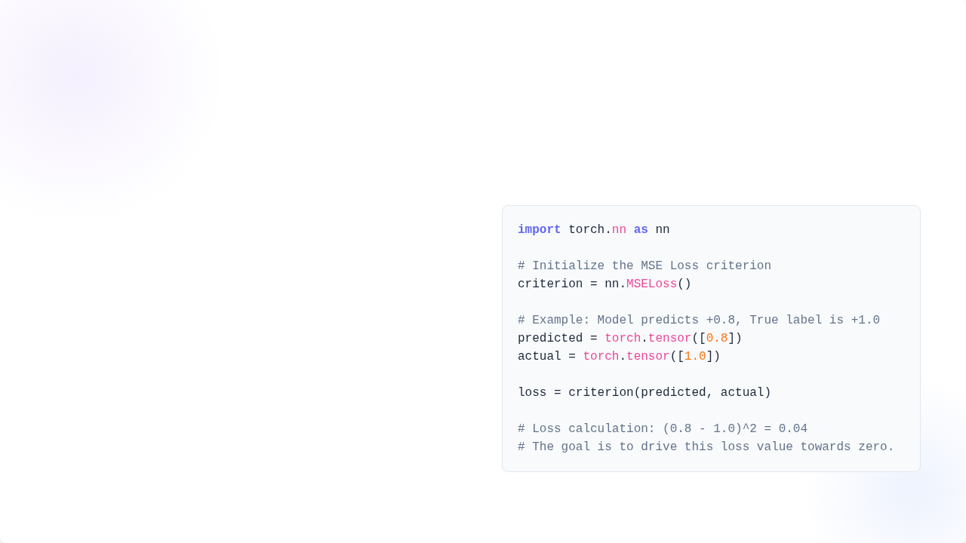
Concept: The Loss Function (MSE)
Minimizing Error Through Squared Differences
PyTorch MSE Loss
The Mean Squared Error (MSE) is ideal for regression tasks like predicting a continuous score (-1.0 to 1.0). It squares the difference between the **Predicted** value and the **Actual** (True) value.
Squaring the error penalizes larger mistakes more heavily, encouraging the model to become highly accurate.

Slide 11
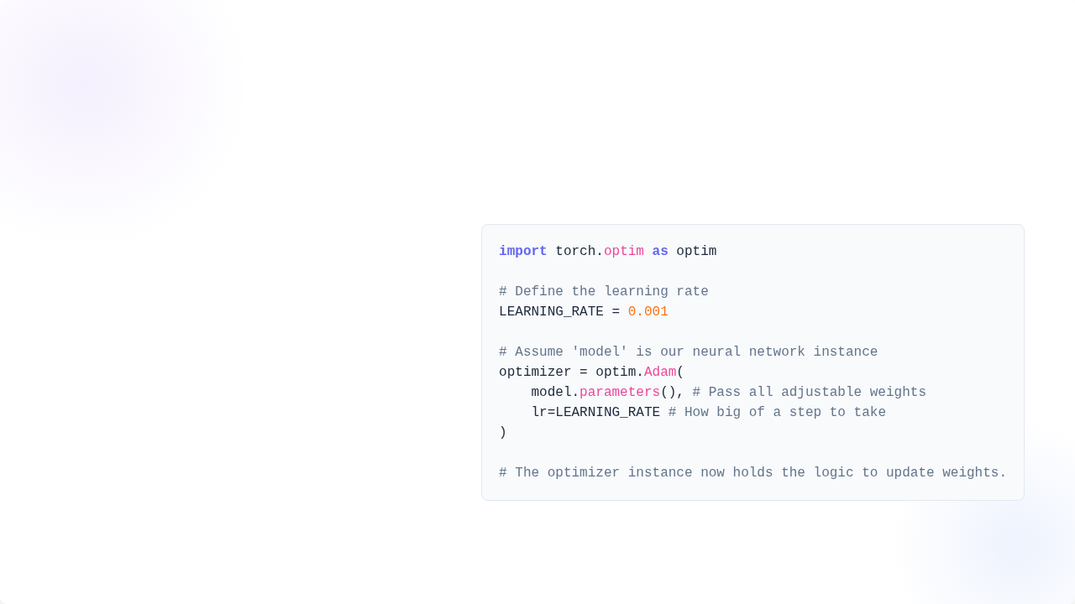
Concept: The Optimizer (Adam)
Adaptive Moment Estimation
PyTorch Adam Optimizer
We use the **Adam** optimizer, which is the industry standard. It's an extension of Gradient Descent that uses adaptive learning rates for each weight.
The **Learning Rate (LR)** is crucial: it controls the size of the steps the optimizer takes. Too large, and the model overshoots; too small, and training takes forever.

Slide 12
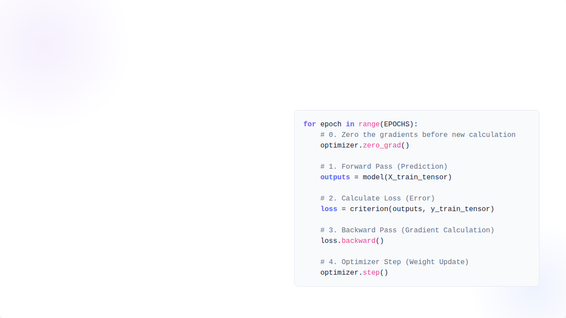
The Training Loop (Code Integration)
The PyTorch Training Code
The Engine of Machine Learning
An **Epoch** is one full pass over the entire training dataset. For each batch of data, we perform the four critical steps:
1.
**Forward Pass:** Calculate the prediction.
2.
**Calculate Loss:** Measure the error.
3.
**Backward Pass:** Calculate the gradient (how weights should change).
4.
**Optimizer Step:** Apply the calculated changes.

Slide 13
The Business Value: Decisions, Not Just Data
Leveraging the AI Score
The resulting sentiment score (-1.0 to +1.0) is instantly actionable and allows us to shift from reactive monitoring to **proactive data-driven strategy**.
•
**Auto-Routing:** Direct highly negative chats to senior agents.
•
**A/B Testing:** Quantify the sentiment impact of different email subject lines.
•
**Product Feedback Loop:** Automatically tag and aggregate negative comments related to specific product features.

Slide 14
Questions?
Thank you for your time.

